Slide 1

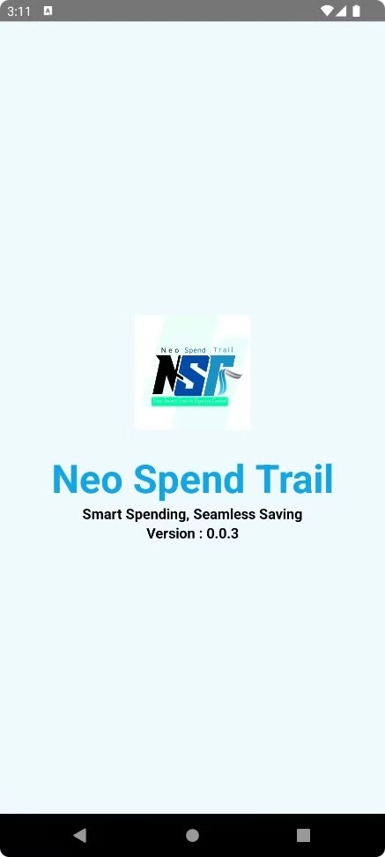
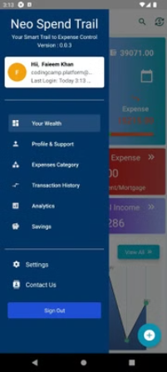
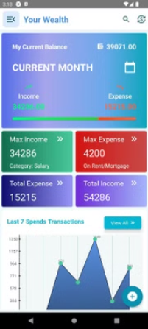
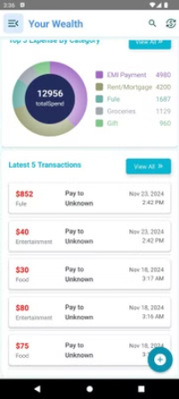

Neo Spend Trail
Your Smart Trail to Expense Control

Slide 2

Neo Spend Trail: Your Smart Trail to Expense Control
Introducing Neo Spend Trail - a comprehensive finance management app that empowers you to take control of your expenses, create smart budgets, and achieve your financial goals with ease.

Slide 3
Seamless Expense Tracking
Capture Spending in Real-Time
Automated Categorization
Easily log your purchases as they happen, ensuring accurate and up-to-date records of your spending.
Neo Spend Trail intelligently categorizes your transactions, helping you stay organized and gain insights.

Slide 4

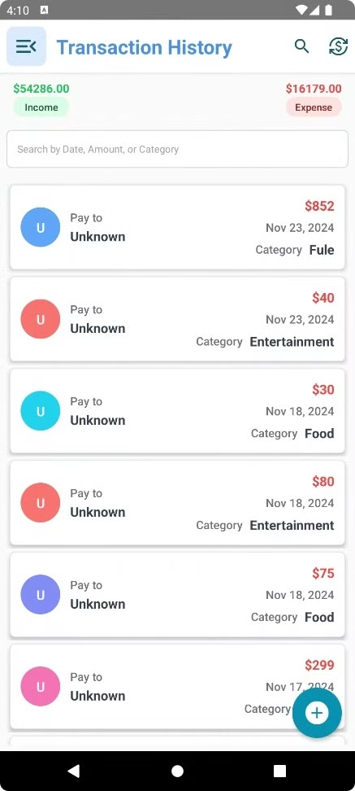
Track Your Transactions and Analyze your Spending Patterns
With Neo Spend Trail, you can easily track your transactions and gain valuable insights into your spending patterns. The app provides detailed reports and analysis, allowing you to understand where your money is going and make informed financial decisions. Take control of your finances and achieve your financial goals with Neo Spend Trail.

Slide 5
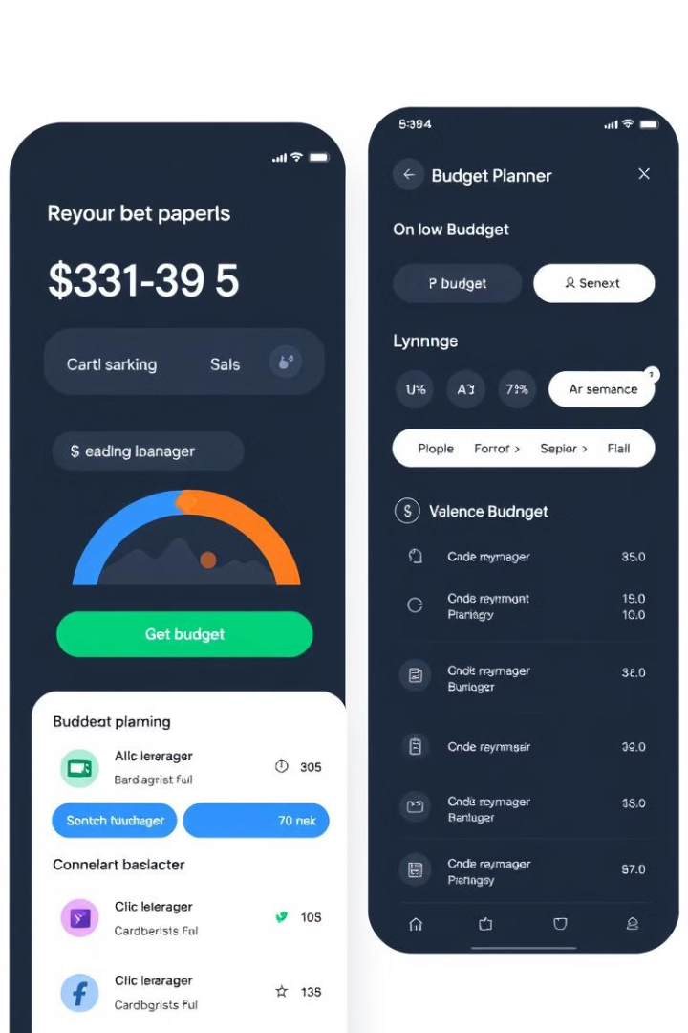
Powerful Budget Planning
Set Spending Limits
Allocate Funds with Ease
Define budget categories and set spending limits to keep your finances on track.
Effortlessly distribute your income across different budget categories to optimize your spending.

Slide 6
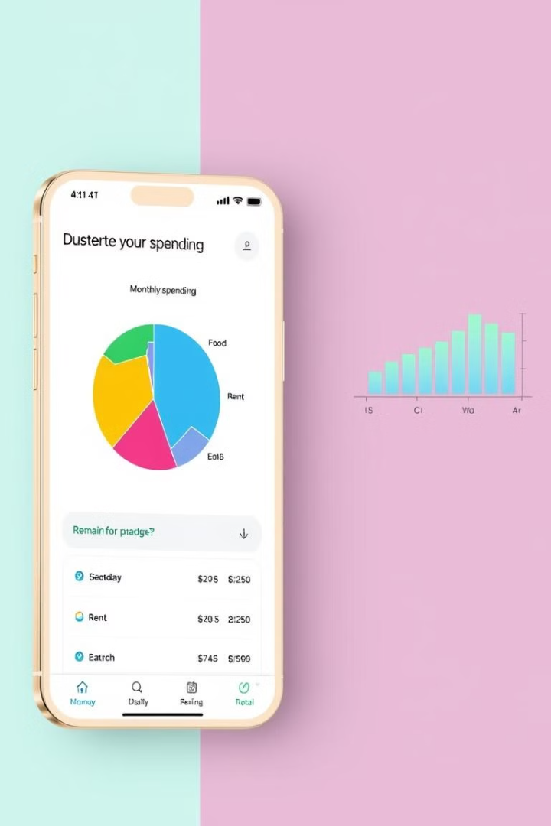
Insightful Spend Analysis
1
Visualize Spending Patterns
Gain valuable insights into your spending habits through intuitive data visualizations.
2
Identify Areas for Savings
Pinpoint opportunities to cut back on unnecessary expenses and allocate funds more effectively.
3
Make Informed Decisions
Use data-driven insights to make smart financial decisions and reach your goals.

Slide 7
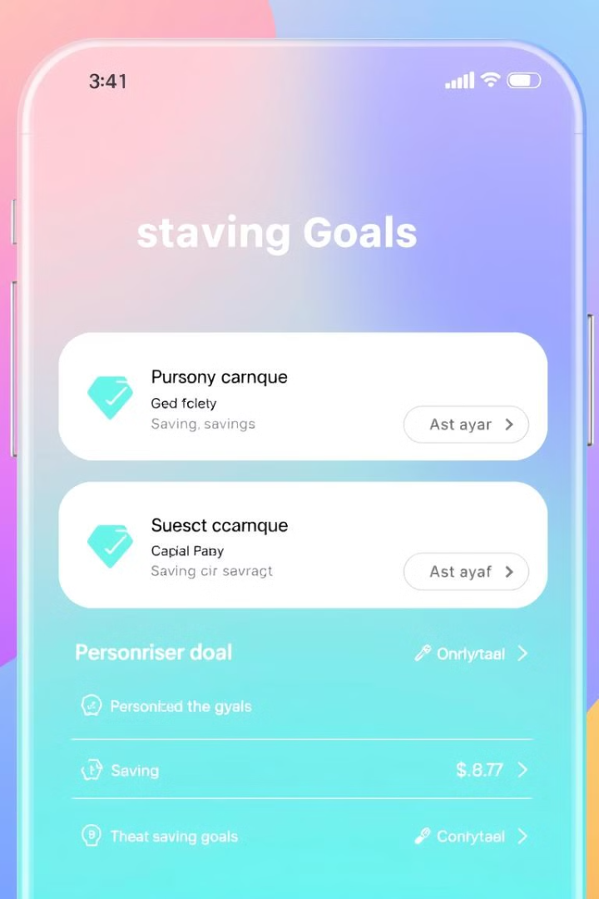
Personalized Savings Goals
1
Define Your Milestones
2
Allocate Funds Automatically
Set specific savings targets and timelines to keep you motivated and on track.
Automatically transfer funds to your savings account to help you reach your goals.
3
Track Progress with Ease
Monitor your savings progress and receive alerts to celebrate your achievements.

Slide 8
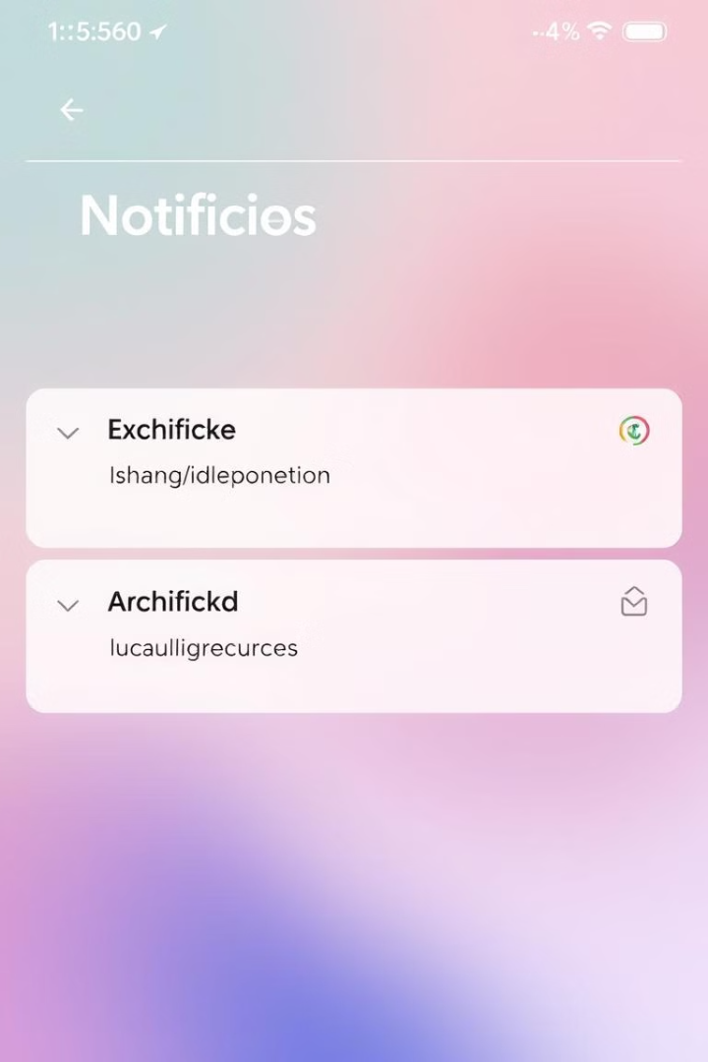



Intelligent Alerts and Notifications
Low Balance Alerts
Receive timely notifications when your account balance falls below a specified threshold.
Budget Limit Alerts
Stay informed when you're approaching or exceeding your budget limits in specific categories.
Bill Payment Reminders
Never miss a bill payment with customizable reminders and due date notifications.

Slide 9



Secure and Reliable
Data Encryption
1
Your sensitive financial data is protected with industry-leading encryption standards.
Secure Authentication
2
Robust security features, such as biometric login, safeguard your account from unauthorized access.
Trusted Platform
3
Neo Spend Trail is built on a reliable and secure platform, giving you peace of mind.

Slide 10
Seamless Integration
Connect Bank Accounts
1
Sync your bank accounts with Neo Spend Trail for comprehensive financial management.
Import Transaction Data
2
Automatically import your transaction history for accurate and up-to-date records.
Manage All Finances in One Place
3
Consolidate your financial information, making it easier to track and analyze your spending.

Slide 11
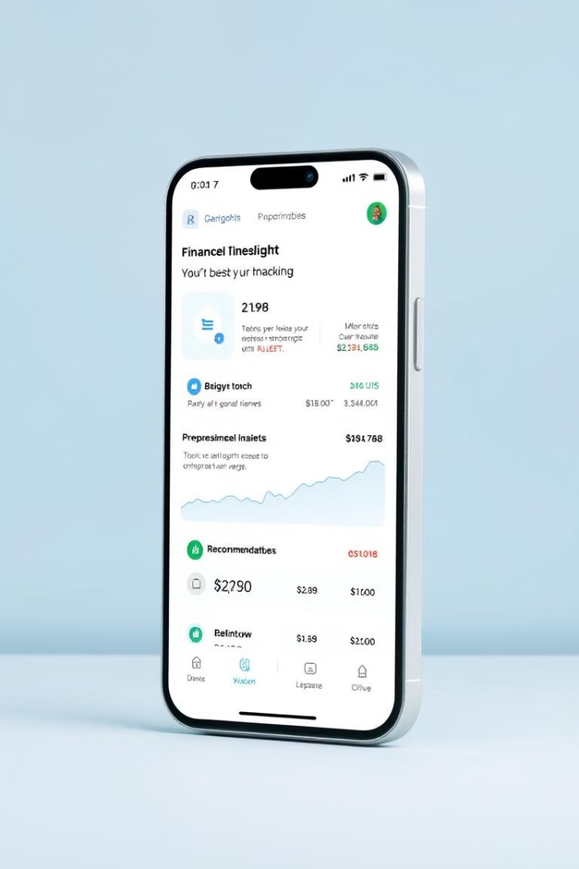
Personalized Insights and Recommendations
5%
Savings Suggestions
Receive personalized recommendations on how to optimize your savings and spending.
15%
Budget Adjustments
Smart analytics identify areas where you can adjust your budget for better results.
20%
Spend Reduction
Intelligent algorithms suggest ways to cut back on unnecessary expenses.

Slide 12
Take Control of Your Finances with Neo Spend Trail
Simplify Expense Tracking
Optimize Your Budget
Set spending limits, allocate funds, and receive alerts to stay on top of your finances.
Easily capture and categorize your spending in real-time for greater financial visibility.

Slide 13

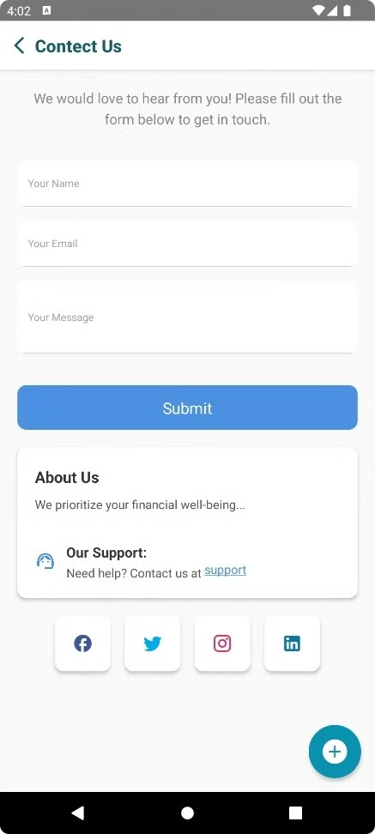
Thank You…
If you have any questions, Please Ask…

